Slide 1
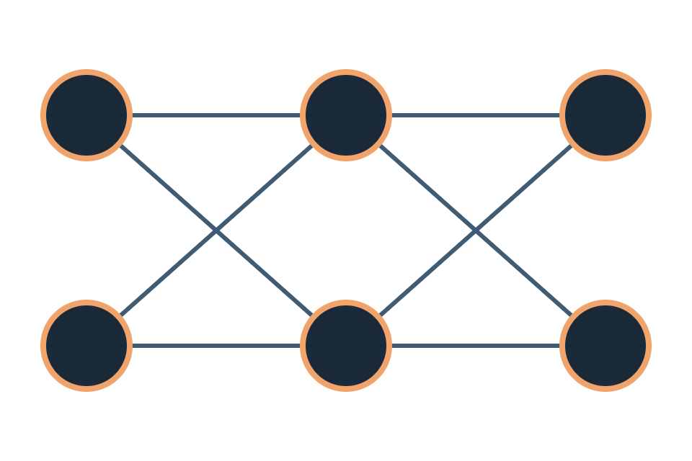
IT2011 · ARTIFICIAL INTELLIGENCE AND MACHINE LEARNING
Backpropagation,
step by step
A worked example on a 2–2–2 network, following every number from the input to the weight update
Dr. Lakmini Abeywardhana · Faculty of Computing, SLIIT · Example after Matt Mazur, “A Step by Step Backpropagation Example” (2015)
Notes:
Today we take one tiny network and do a single full training step by hand: forward pass, error, backward pass, and weight update. Every number on these slides can be checked with a calculator. The example and its numbers follow Matt Mazur's well-known 2015 tutorial.

Slide 2

THE BIG PICTURE
What backpropagation does
The network makes a prediction and we measure how wrong it is. Then we nudge every weight a little in the direction that reduces the error. Backpropagation is the bookkeeping that finds that direction for all weights at once, using the chain rule.
1
2
3
4
Forward pass
Error
Backward pass
Update
Inputs flow through the layers to produce outputs
Compare the outputs with the targets
The chain rule gives ∂E/∂w for every weight
w ← w − η·∂E/∂w, then repeat
IT2011 · Backpropagation, step by step
2
Notes:
Keep the four steps in mind; every later slide belongs to one of them. The gradient ∂E/∂w tells us how the error changes if we increase w slightly. We step against it, scaled by the learning rate η.

Slide 3
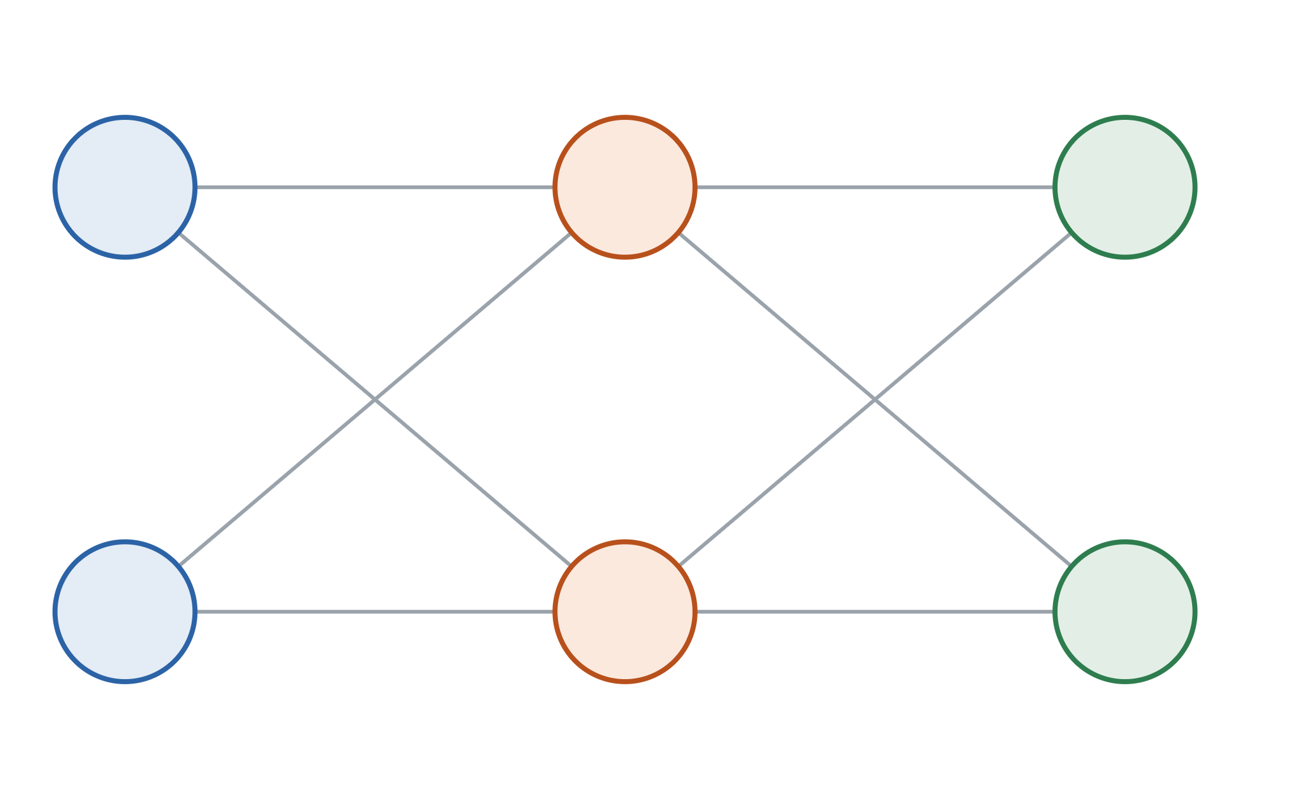
SETUP
The example network
Input
Hidden
Output
The numbers
i1
w1 = .15
h1
w5 = .40
o1
Inputs i1 = 0.05, i2 = 0.10
Targets o1 → 0.01, o2 → 0.99
w3 = .25
w7 = .50
Biases b1 = 0.35, b2 = 0.60 (shared per layer)
Activation sigmoid σ(x) = 1 / (1 + e^−x)
w2 = .20
w6 = .45
Error squared error, ½(target − out)²
i2
w4 = .30
h2
w8 = .55
o2
Learning rate η = 0.5
+ bias b1 = 0.35
+ bias b2 = 0.60
IT2011 · Backpropagation, step by step
3
Notes:
Two inputs, two hidden neurons, two outputs, and eight weights. Naming: w1 and w2 feed h1, w3 and w4 feed h2, w5 and w6 feed o1, w7 and w8 feed o2. In this example one bias value is shared by each layer. The goal: given inputs 0.05 and 0.10, output 0.01 and 0.99.

Slide 4
STEP 1 · FORWARD PASS
Hidden layer: weighted sum, then squash
Each neuron adds its weighted inputs and the bias to get net, then applies the sigmoid σ(x) = 1 / (1 + e^−x) to get out.
Neuron h1
Neuron h2
net_h1 = w1·i1 + w2·i2 + b1
net_h2 = w3·i1 + w4·i2 + b1
= 0.15×0.05 + 0.20×0.10 + 0.35
= 0.25×0.05 + 0.30×0.10 + 0.35
= 0.3775
= 0.3925
out_h1 = σ(0.3775) = 0.593269992
out_h2 = σ(0.3925) = 0.596884378
IT2011 · Backpropagation, step by step
4
Notes:
Ask students to verify one of these on a calculator: 1/(1+e^−0.3775) = 0.5933. Keep the distinction between net (before the activation) and out (after it); the backward pass needs both.

Slide 5
STEP 1 · FORWARD PASS
Output layer: the same two steps
Now the hidden outputs out_h1 and out_h2 act as the inputs.
Neuron o1
Neuron o2
net_o1 = w5·out_h1 + w6·out_h2 + b2
net_o2 = w7·out_h1 + w8·out_h2 + b2
= 0.40×0.5933 + 0.45×0.5969 + 0.60
= 0.50×0.5933 + 0.55×0.5969 + 0.60
= 1.105905967
= 1.224921404
out_o1 = σ(1.1059) = 0.75136507
out_o2 = σ(1.2249) = 0.772928465
Target 0.01: far too high
Target 0.99: too low
IT2011 · Backpropagation, step by step
5
Notes:
The hidden values are shown rounded to four places to fit, but the calculation uses full precision. With random-ish starting weights the outputs are both around 0.75, nowhere near 0.01 and 0.99. That gap is what training will close.

Slide 6
STEP 2 · ERROR
How wrong is the network?
E_total = Σ ½ (target − out)²
Total error
E_o1 = ½(0.01 − 0.75136507)²
0.298371109
= 0.274811083
E_o2 = ½(0.99 − 0.772928465)²
= 0.023560026
This is the number every weight update will try to shrink.
The ½ is there only for convenience: it cancels the 2 when we differentiate.
IT2011 · Backpropagation, step by step
6
Notes:
Most of the error comes from o1, which should be 0.01 but outputs 0.75. Squared error punishes large mistakes much more than small ones.

Slide 7
STEP 3 · BACKWARD PASS · OUTPUT LAYER
The key idea: a chain of three questions
∂E_total/∂w5 = ∂E_total/∂out_o1 × ∂out_o1/∂net_o1 × ∂net_o1/∂w5
∂E_total/∂out_o1
∂out_o1/∂net_o1
∂net_o1/∂w5
How much does the error change when out_o1 changes?
How much does out_o1 change when its net input changes?
How much does net_o1 change when w5 changes?
= −(target − out_o1)
= out_o1(1 − out_o1)
= out_h1
IT2011 · Backpropagation, step by step
7
Notes:
w5 affects the error only through net_o1, which affects out_o1, which affects E. The chain rule multiplies the local rates of change along that path. The middle factor is the derivative of the sigmoid, which conveniently can be written using its own output: σ'(x) = σ(x)(1 − σ(x)).

Slide 8
STEP 3 · BACKWARD PASS · OUTPUT LAYER
Worked through for w5
Factor | Computed as | Value
∂E_total/∂out_o1 | −(0.01 − 0.75136507) | 0.74136507
∂out_o1/∂net_o1 | 0.75136507 × (1 − 0.75136507) | 0.186815602
∂net_o1/∂w5 | out_h1 | 0.593269992
∂E_total/∂w5 = 0.74136507 × 0.186815602 × 0.593269992 = 0.082167041
w5⁺ = w5 − η·∂E_total/∂w5 = 0.40 − 0.5 × 0.082167041 = 0.35891648
The first two factors together form the output neuron's delta: δ_o1 = 0.74136507 × 0.186815602 = 0.138498562. We will reuse it in the hidden layer.
IT2011 · Backpropagation, step by step
8
Notes:
The gradient is positive, so increasing w5 would increase the error; we decrease it. Point out that the delta δ_o1 depends only on the output neuron, not on which weight we are updating, so w6 reuses it: ∂E/∂w6 = δ_o1 × out_h2.

Slide 9
STEP 3 · BACKWARD PASS · OUTPUT LAYER
All four output-layer weights
Weight | Connects | ∂E_total/∂w | Old | New
w5 | h1 → o1 | 0.082167041 | 0.40 | 0.35891648
w6 | h2 → o1 | 0.082667628 | 0.45 | 0.408666186
w7 | h1 → o2 | −0.022602540 | 0.50 | 0.511301270
w8 | h2 → o2 | −0.022740242 | 0.55 | 0.561370121
Hold the new values aside. The hidden-layer step still uses the original w5–w8. All eight weights are updated together at the end.
w7 and w8 have negative gradients, so they increase, pushing out_o2 up toward its target of 0.99.
IT2011 · Backpropagation, step by step
9
Notes:
w6 = δ_o1 × out_h2. w7 and w8 use δ_o2 = −0.038098236 times out_h1 and out_h2. Using the original weights matters: the gradient describes the network as it was during the forward pass. Updating w5 before computing the hidden gradients is a common student mistake.

Slide 10
STEP 3 · BACKWARD PASS · HIDDEN LAYER
Hidden layer: h1 feeds both outputs
A change in out_h1 affects both o1 and o2, so its error signal is the sum of both paths, using δ_o1 = 0.138498562 and δ_o2 = −0.038098236.
Factor | Computed as | Value
∂E_total/∂out_h1 | δ_o1·w5 + δ_o2·w7 | 0.036350306
∂out_h1/∂net_h1 | out_h1 × (1 − out_h1) | 0.241300709
∂net_h1/∂w1 | i1 | 0.05
∂E_total/∂w1 = 0.036350306 × 0.241300709 × 0.05 = 0.000438568
w1⁺ = 0.15 − 0.5 × 0.000438568 = 0.149780716
IT2011 · Backpropagation, step by step
10
Notes:
The two paths: δ_o1 × w5 = 0.138498562 × 0.40 = 0.055399425, and δ_o2 × w7 = −0.038098236 × 0.50 = −0.019049118. Their sum is 0.036350306. Note these use the ORIGINAL w5 and w7. This is where "back-propagation" gets its name: the output deltas travel backwards along the weights.

Slide 11
STEP 3 · BACKWARD PASS · HIDDEN LAYER
All four hidden-layer weights
Weight | Connects | ∂E_total/∂w | Old | New
w1 | i1 → h1 | 0.000438568 | 0.15 | 0.149780716
w2 | i2 → h1 | 0.000877135 | 0.20 | 0.19956143
w3 | i1 → h2 | 0.000497713 | 0.25 | 0.24975114
w4 | i2 → h2 | 0.000995425 | 0.30 | 0.29950229
Notice the size: these gradients are about 100× smaller than those for w5–w8.
Every layer we pass back through multiplies by a sigmoid slope of at most 0.25 (and here by small inputs too). This is an early glimpse of the vanishing-gradient problem in deep networks.
IT2011 · Backpropagation, step by step
11
Notes:
w2 = same hidden delta for h1 times i2 = 0.10, which is why it is exactly double w1's gradient. w3 and w4 use h2's delta, computed the same way from δ_o1·w6 + δ_o2·w8. Only now, with all eight gradients in hand, do we apply all the updates.

Slide 12
STEP 4 · UPDATE AND REPEAT
Repeat, and the error melts away
Total error before training
0.298371109
The recipe
Forward: compute net and out for every neuron
Error: E_total = Σ ½(target − out)²
Backward: chain rule gives ∂E/∂w, reusing each δ
Update all weights at once: w ← w − η·∂E/∂w
After 1 update
≈ 0.29103
After 10,000 updates
≈ 0.000035
Outputs ≈ 0.0159 and 0.9841, against targets 0.01 and 0.99.
Simplification: as in the original tutorial, the biases b1 and b2 stay fixed in this example. In practice they are learned too.
IT2011 · Backpropagation, step by step · Example after M. Mazur (2015)
12
Notes:
One step barely moves the error, which is normal with a single example and η = 0.5. Repeating the same four steps 10,000 times drives it close to zero. Exercise idea: have students compute the gradients for w3 and w4 themselves, then compare with slide 11.

